Slide 1
DICAP SURVEY
Results from 327 answers

Slide 2
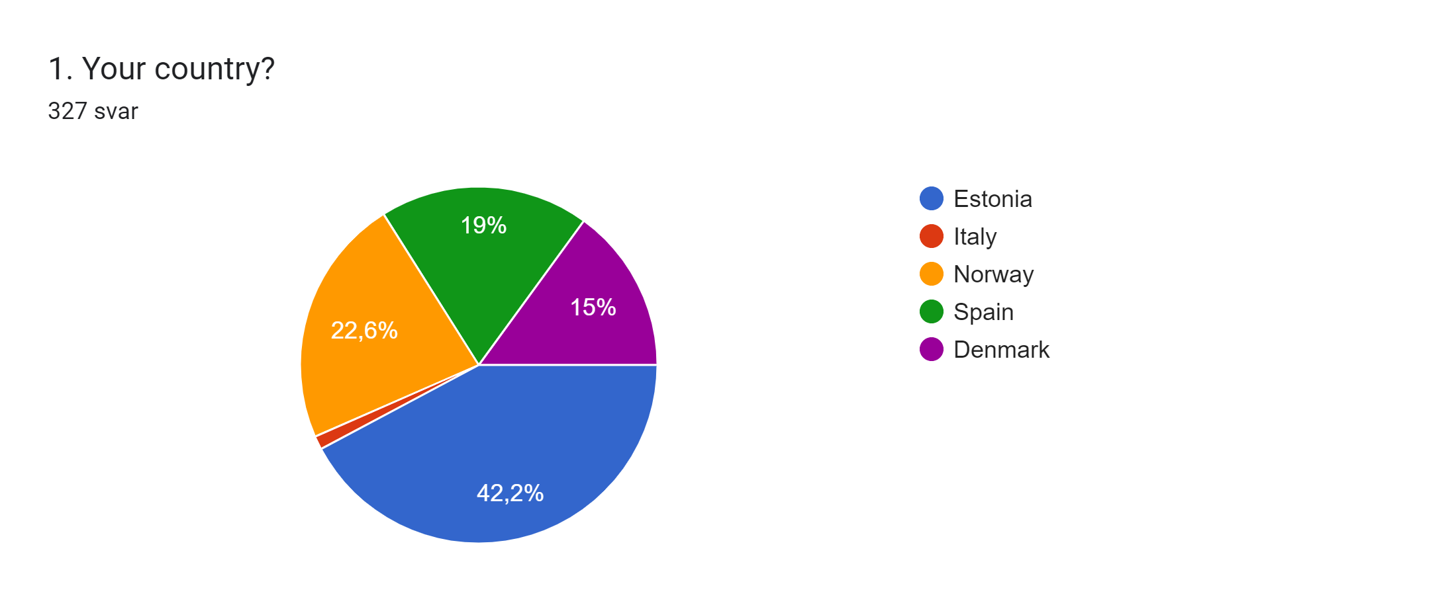
Country of Origen

Slide 3
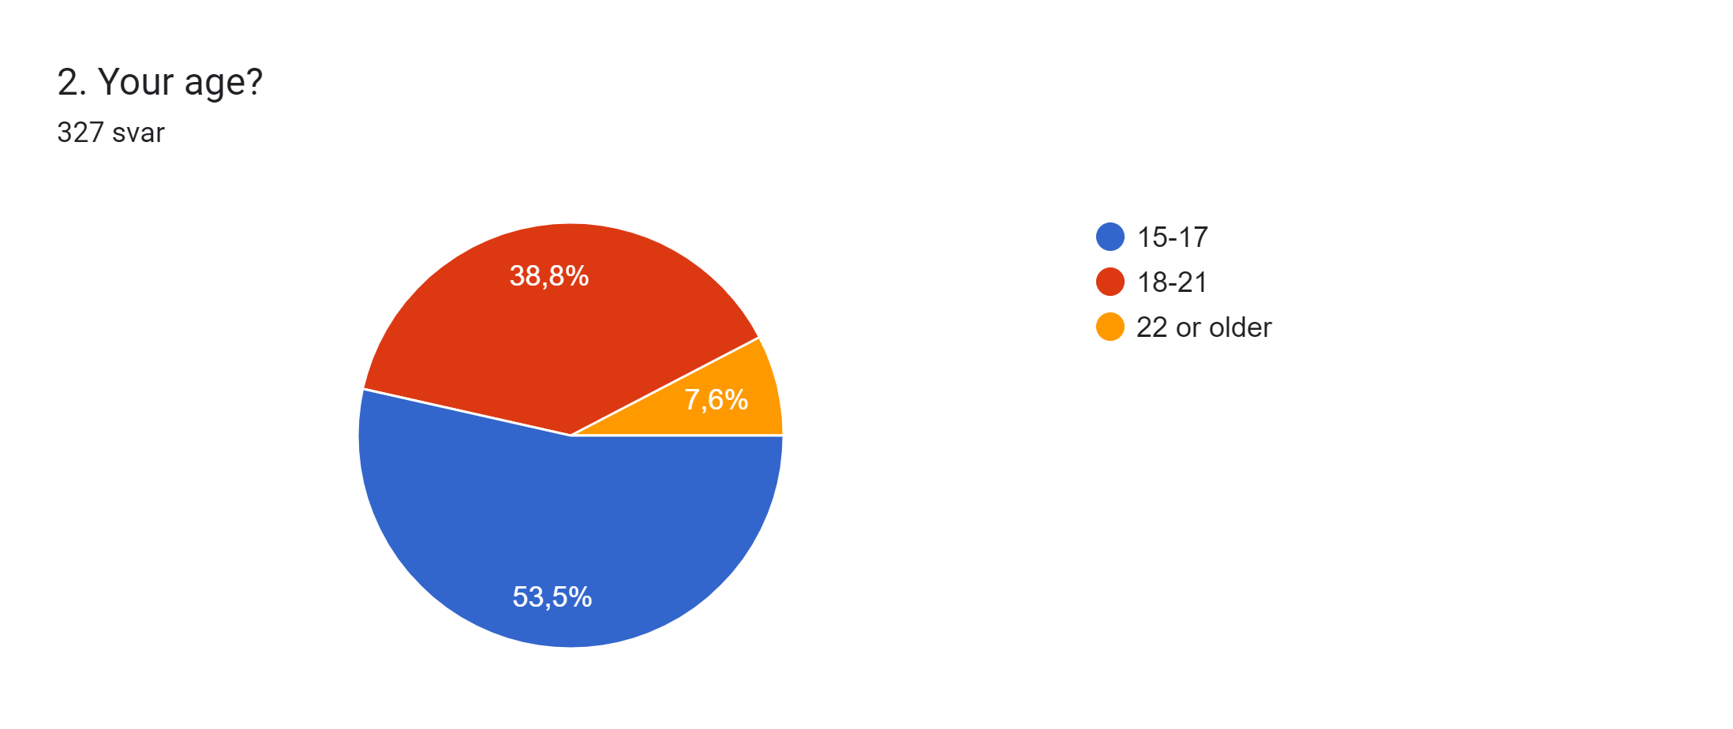
Age of the Respondants

Slide 4
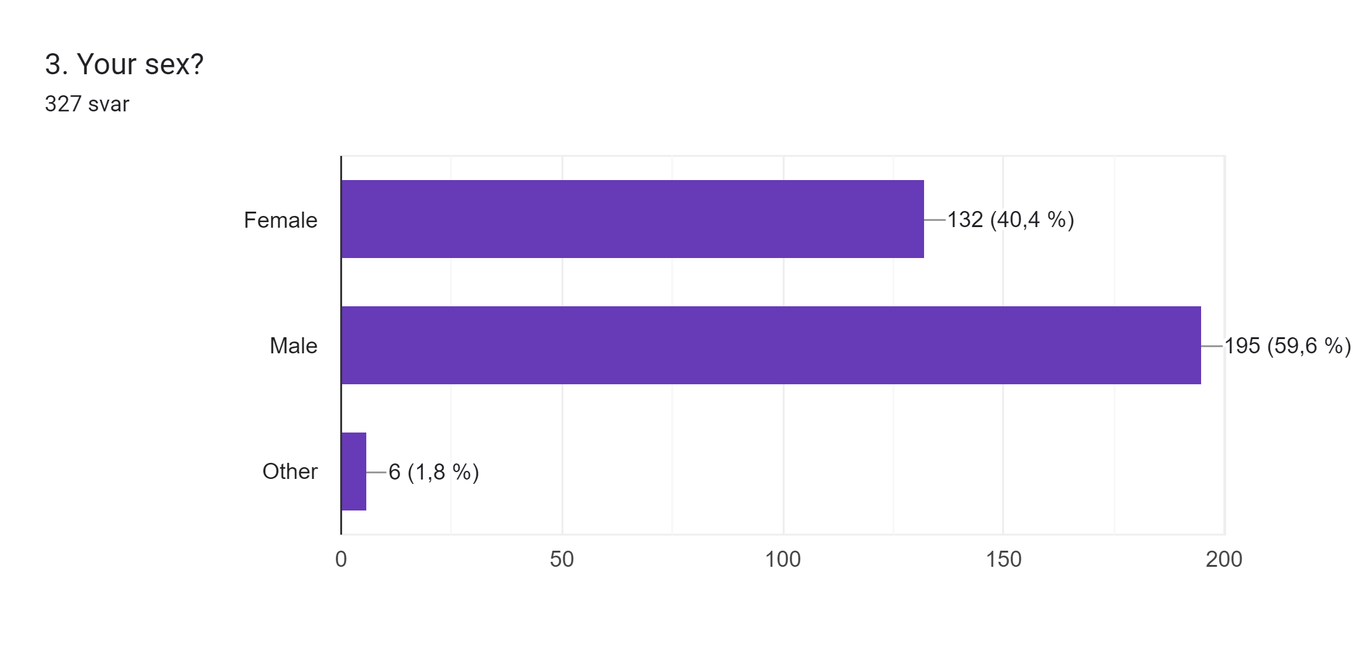
Gender of the Respondants

Slide 5
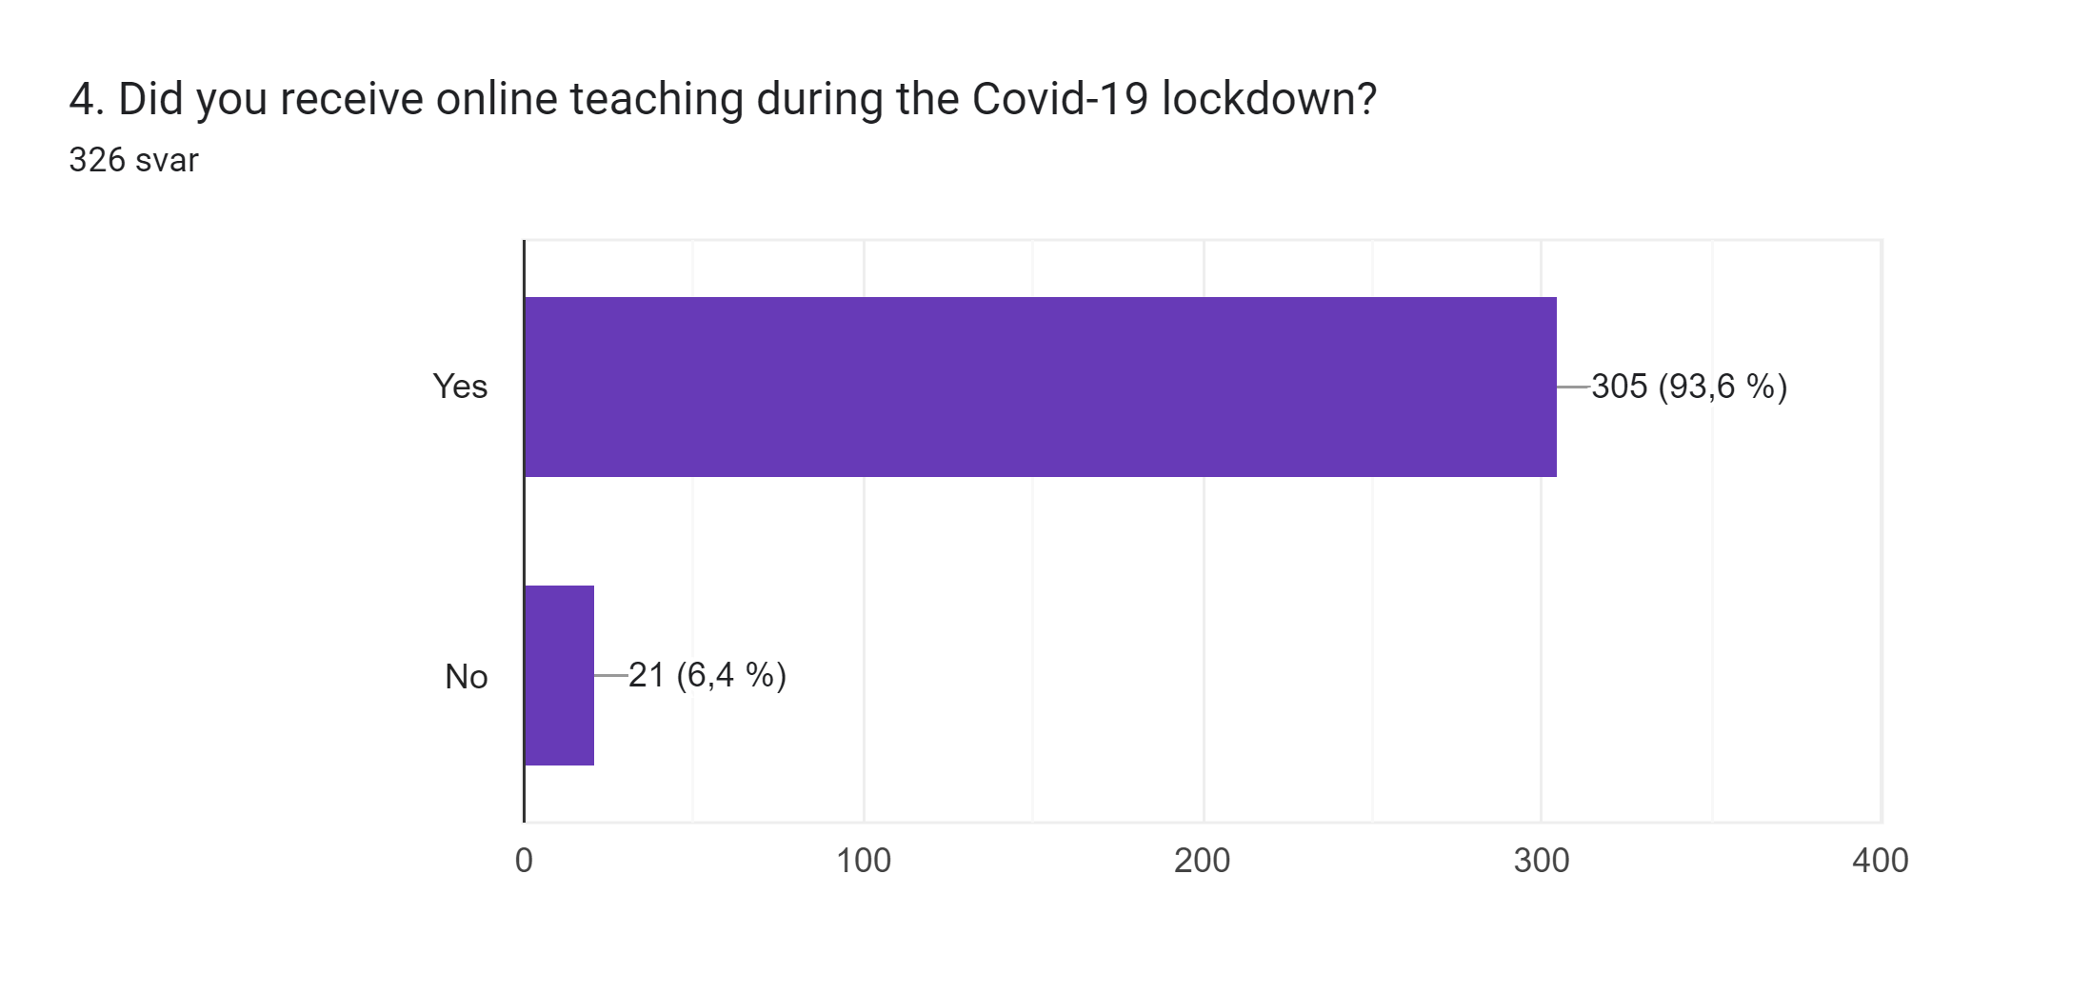
Online Teaching

Slide 6
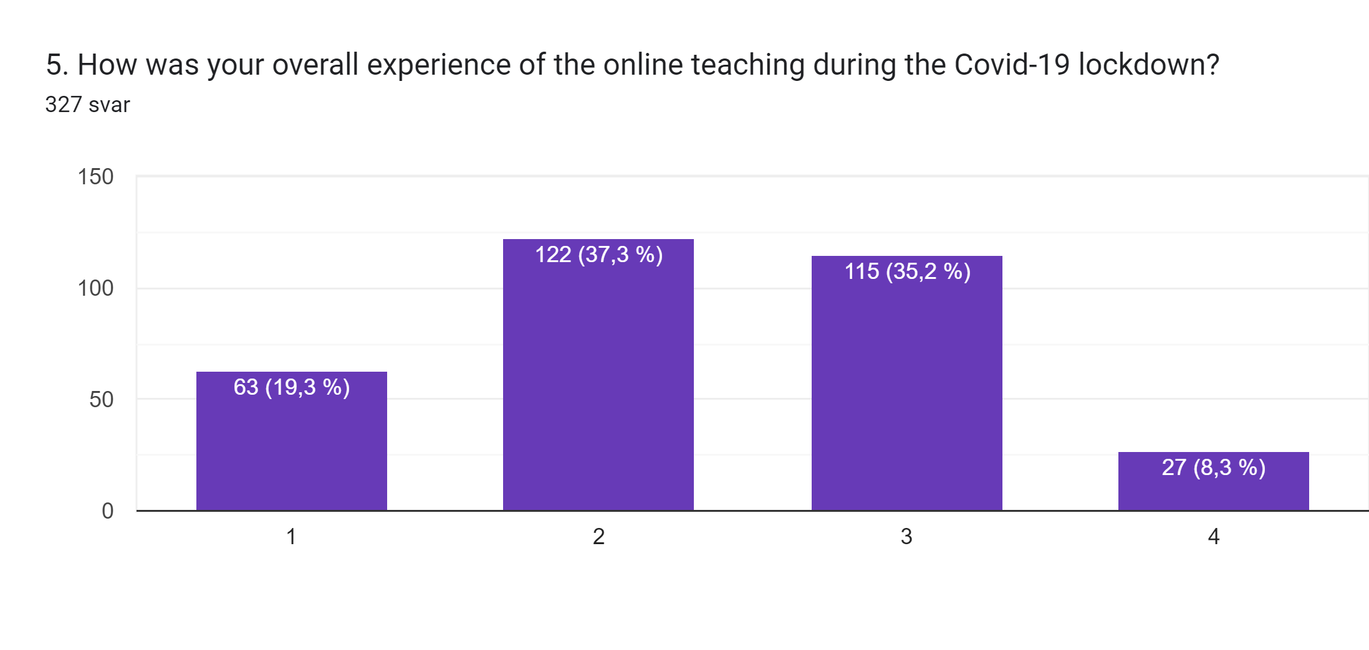
Overall Experience with Online Teaching
Notes:
1 = Great
4= Bad

Slide 7
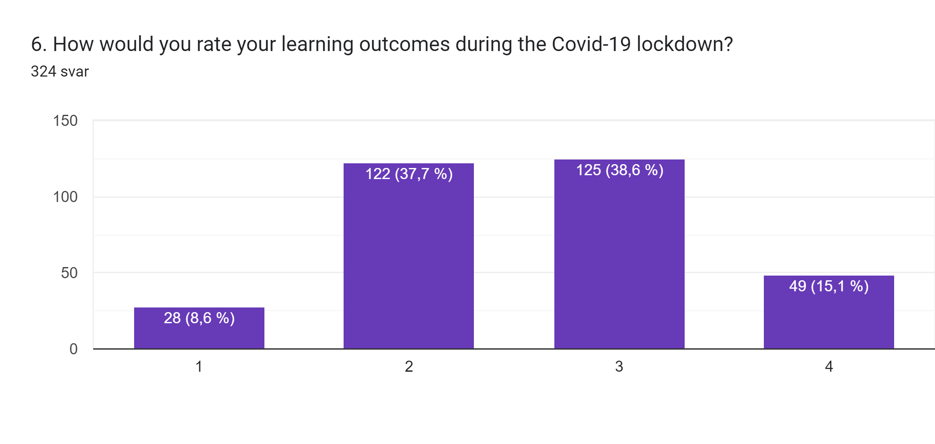
Rating of Learning Outcome
Notes:
1= Great
4= Bad

Slide 8
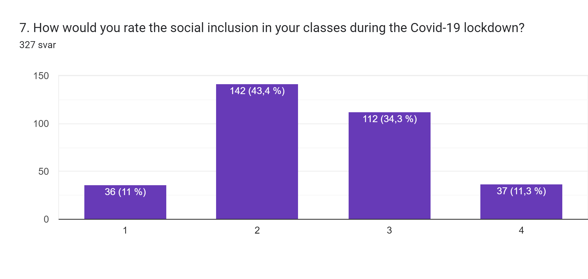
Rating of Social Inclusion in your class
Notes:
1= Great
4= Bad

Slide 9
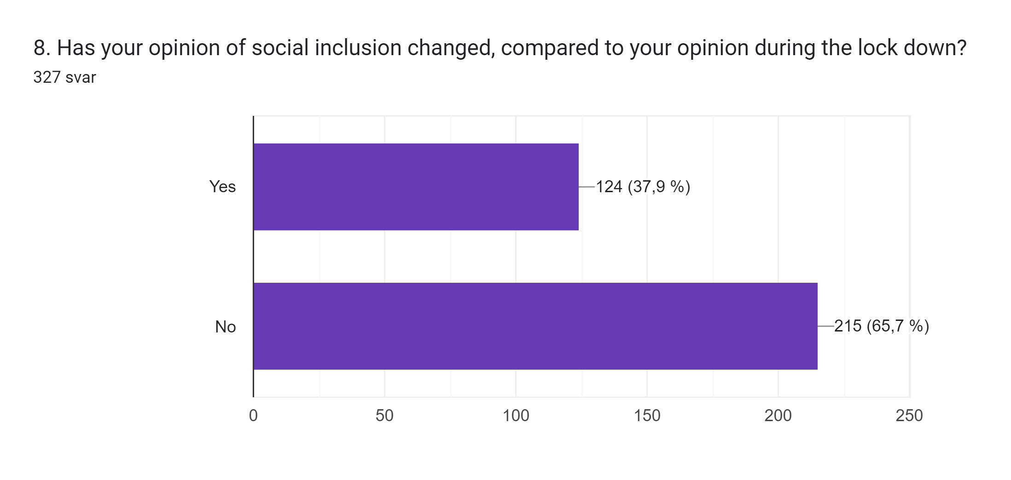
Opinion on Social Inclusion

Slide 10
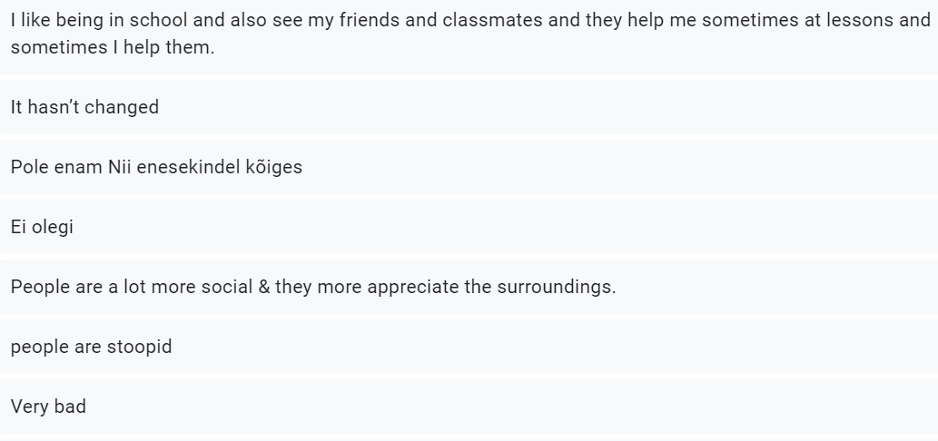
In what Way has Your Opinion Changed?

Slide 11
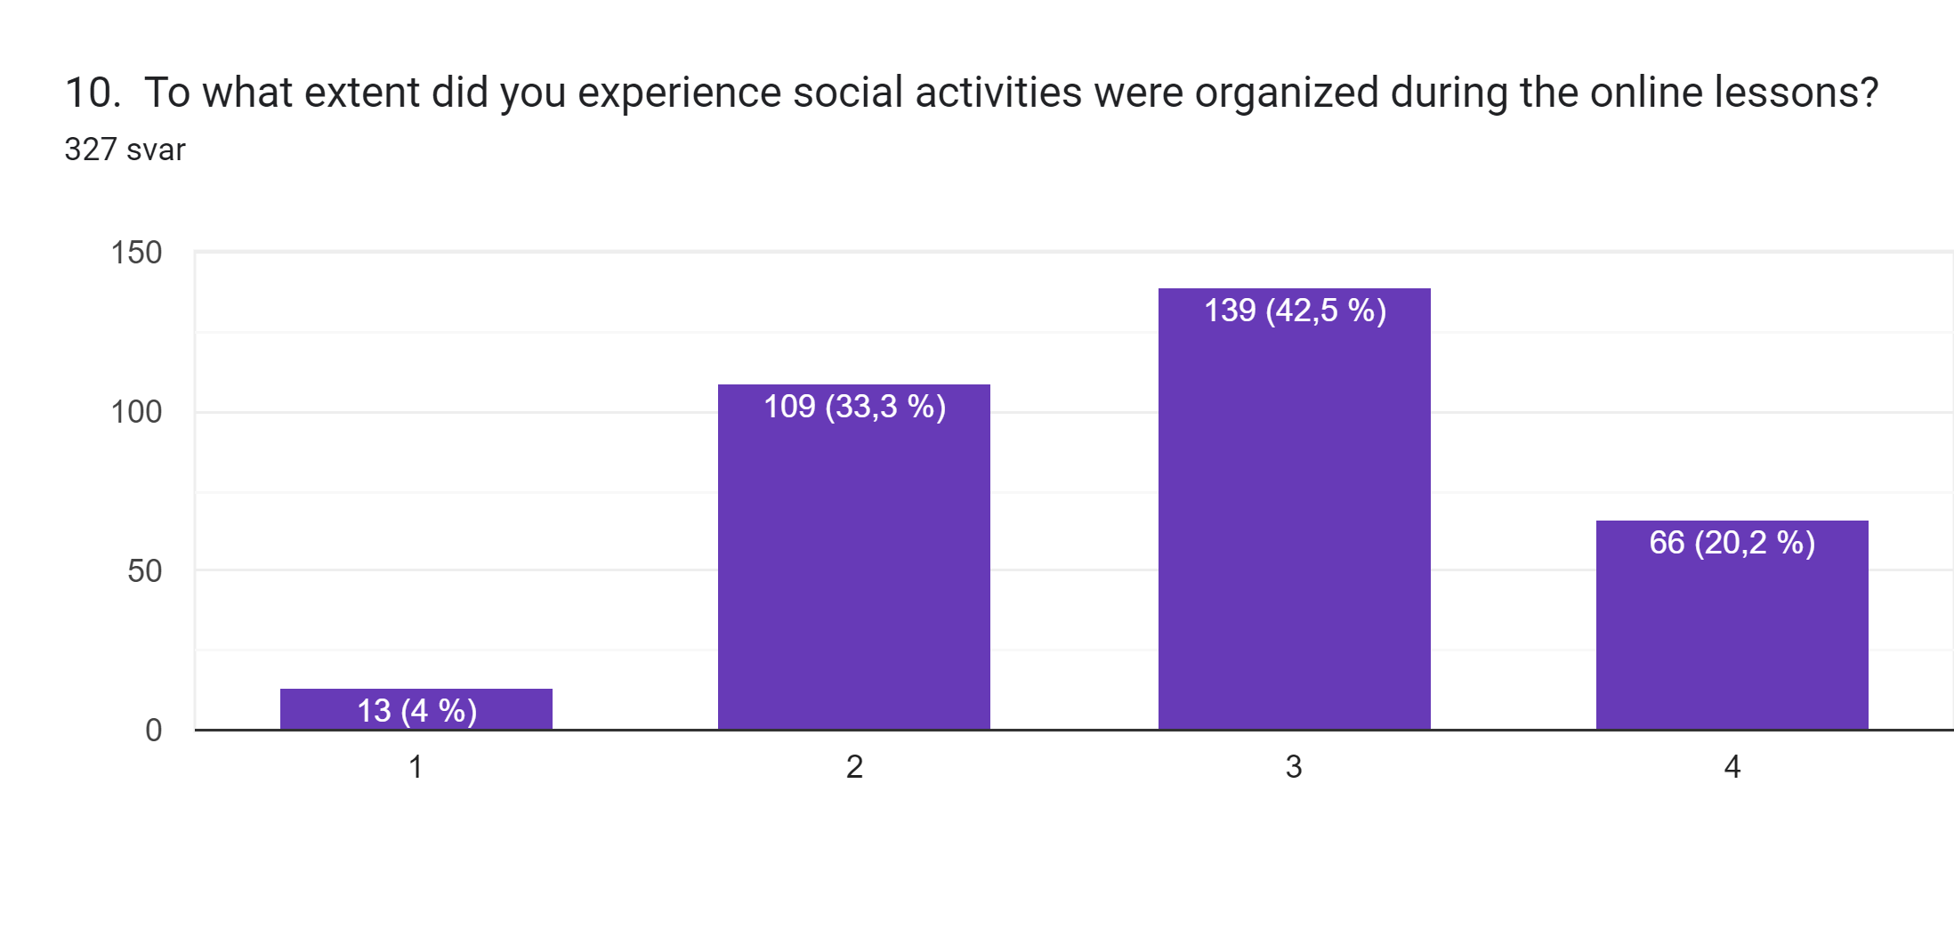
Social Activities Organized.

Slide 12
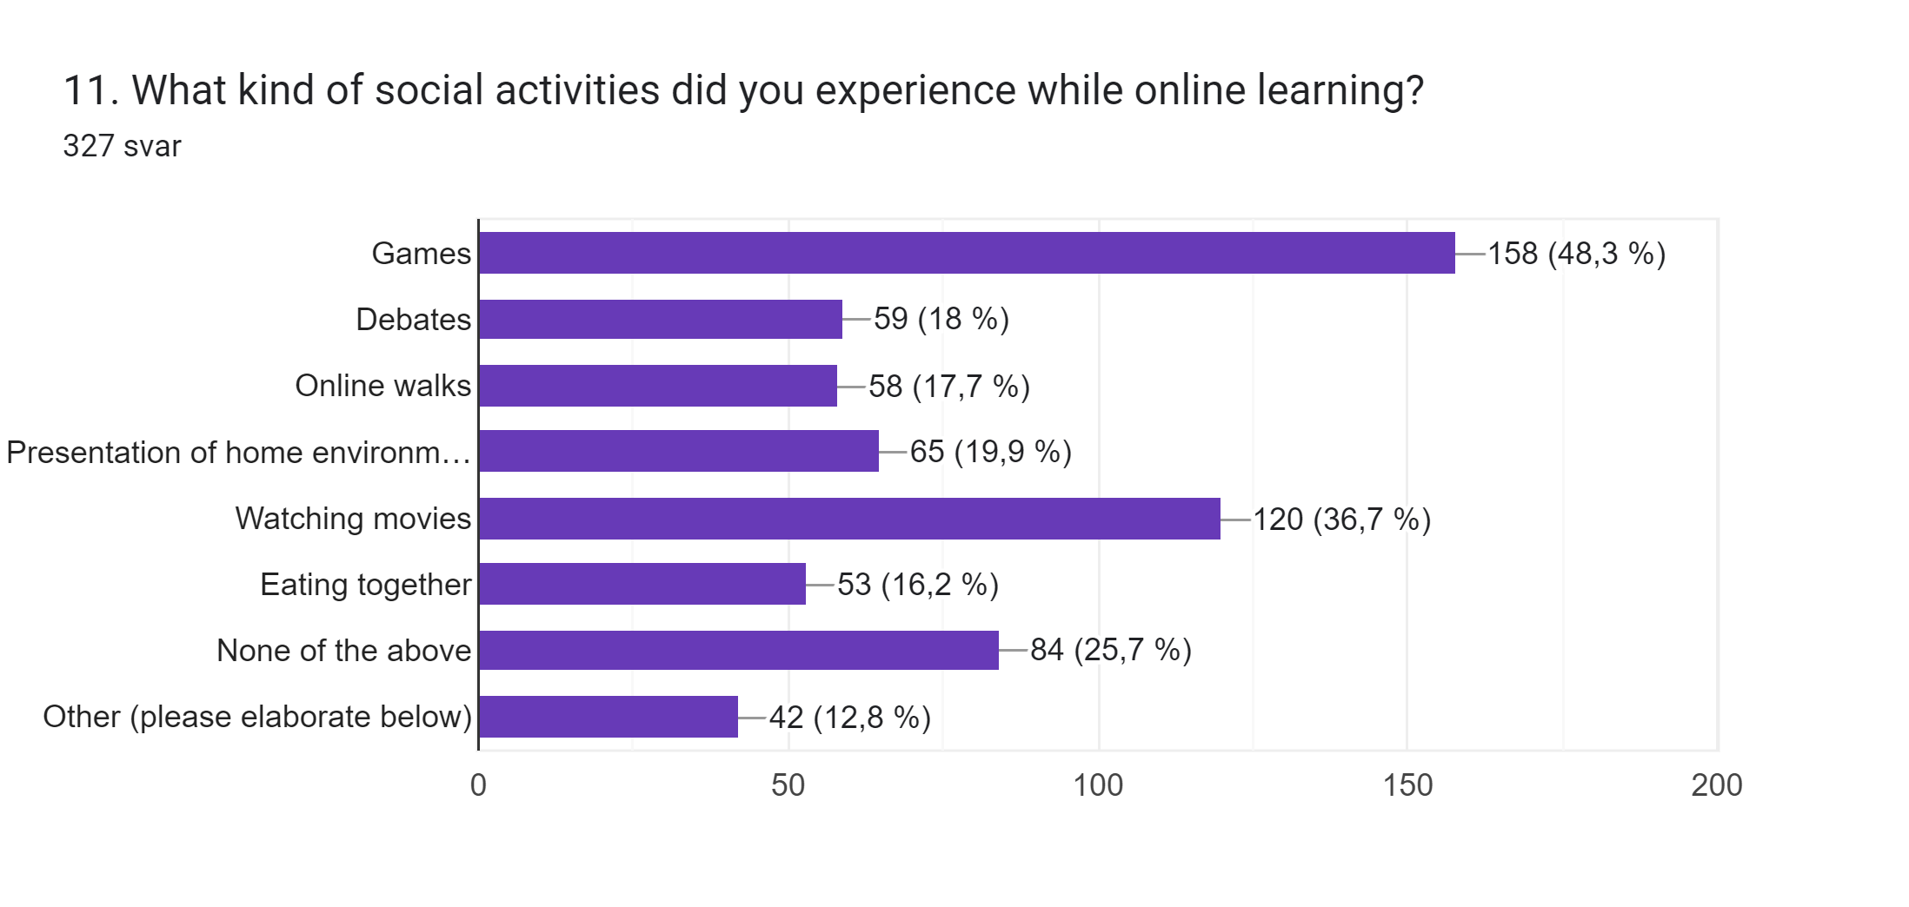
Different Social Activities

Slide 13
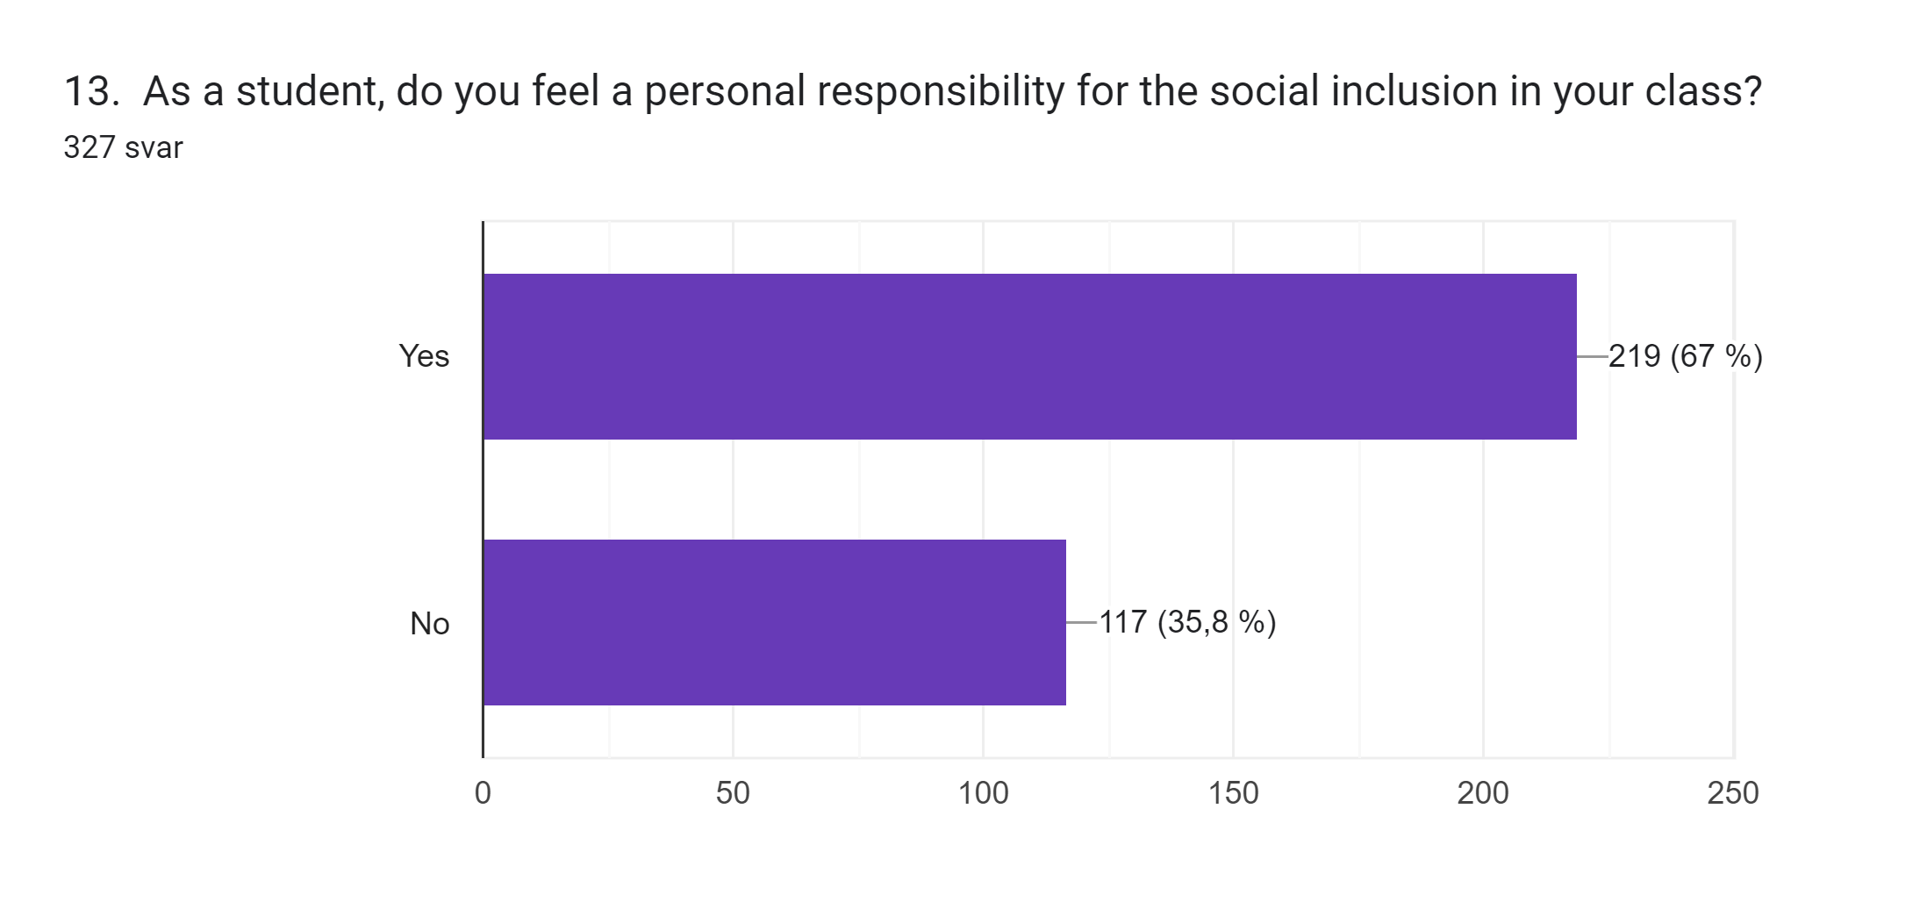
Personal Responsability

Slide 14
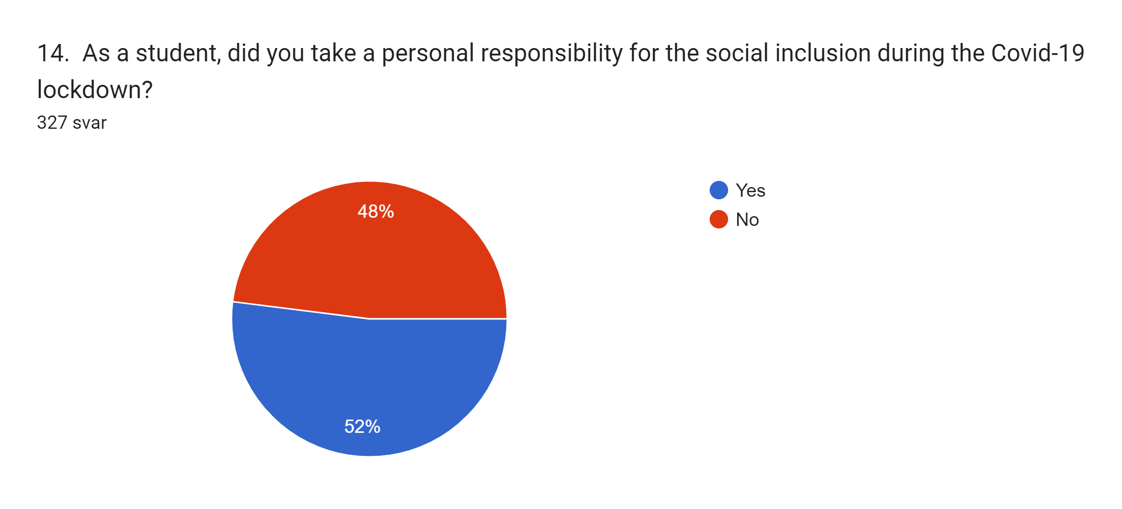
Personal Responsability for Social Inclusion

